Slide 1
Image Based Street Pothole Detection
Archana Yadawa
Anjani Mallampati
Divya Sidhabathuni
Sweety Sojrani
Group 10
Instructor: Dr. Jerry Gao

Slide 2
Introduction
Problem
$3 billion annually to repair damage caused by potholes
Current Solutions
Land Rover vehicles have a built-in pothole detection system
all-new Ford Focus pothole detection system
Proposed Solution
use machine learning and artificial intelligence algorithms to create an accurate and efficient pothole detection system
will reduce the country’s annual spending cost in repairing the roads.

Slide 3
Data Preparation
Used labelImg
Split 2500 images into 2000 train 500 test
Positive: label pothole
Negative: select entire image and label as no_pothole
Test: Categorize into positive or negative and label accordingly

Slide 4
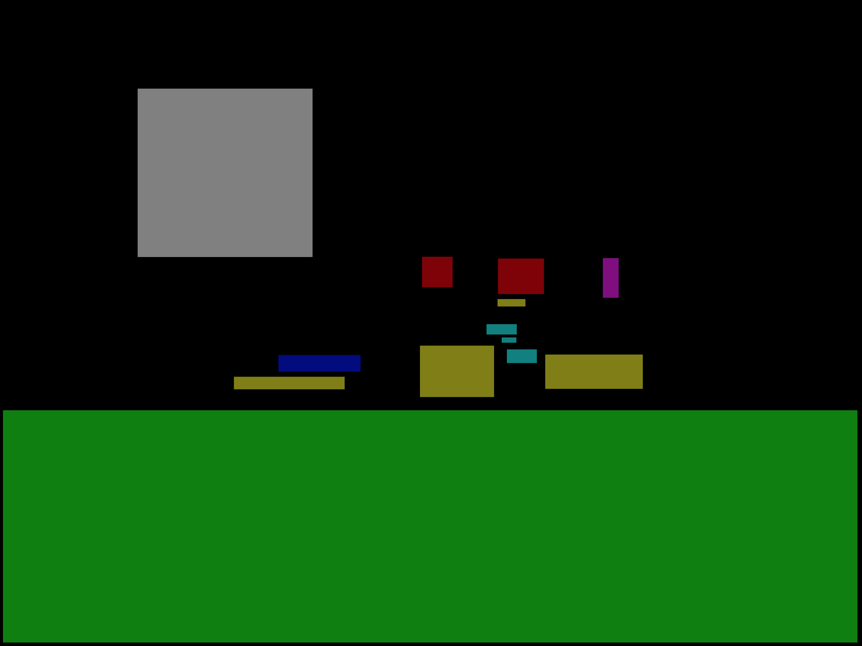
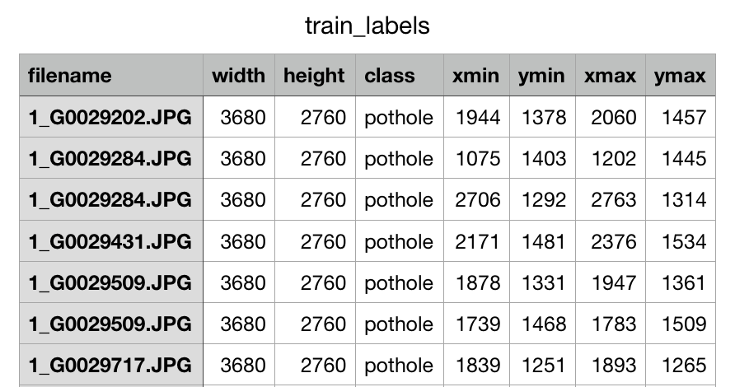
Data Preparation (cont’d)
Generate dataset using LabelImg
JPEG file to XML
Convert XML to CSV
Convert CSV to train.record

Slide 5
Selected Models
YOLO
SSD
CNN
Faster R-CNN

Slide 6
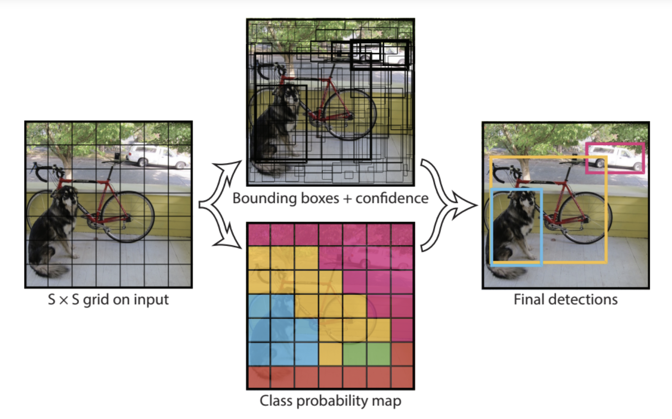
YOLO
Split images into a X by X grid
For each of the grids, take m bounding boxes which enclose an object
Outputs a confidence score:
How certain the predicted bounding box actually encloses some object
Figure. Architecture of YOLO
Notes:
YOLO:
YOLO or You Only Look Once is an object detection algorithm much different from the region based algorithms seen above. In YOLO a single convolutional network predicts the bounding boxes and the class probabilities for these boxes.
How YOLO works is that we take an image and split it into an SxS grid, within each of the grid we take m bounding boxes. For each of the bounding box, the network outputs a class probability and offset values for the bounding box. The bounding boxes having the class probability above a threshold value is selected and used to locate the object within the image.
YOLO is orders of magnitude faster(45 frames per second) than other object detection algorithms. The limitation of YOLO algorithm is that it struggles with small objects within the image, for example it might have difficulties in detecting a flock of birds. This is due to the spatial constraints of the algorithm.
Object Detection Algorithm
Predicting classes and bounding boxes for the whole image in one run of the algorithm
A single convolutional network predicts the bounding boxes and the class probabilities for these boxes
Split an image into a SxS grid and take m bounding boxes
Each bounding box has a class probability and offset value
Bounding boxes above a threshold value are selected and used to locate the object within the image

Slide 7
 | YOLO | SSD | CNN | Faster RCNN
Why? | Speed Different from other object detection algorithms because it only needs to “see” an image once Swift -- can be run real time | Speeds up process by eliminating the need of region proposal network Provides matchable accuracy while using lower resolution images | Uses feature learning to find most relevant pattern for classification | Uses RPN to generate fix set of regions Uses anchor boxes for object detection Faster speed because of regional proposals (real-time object detection)

Slide 8
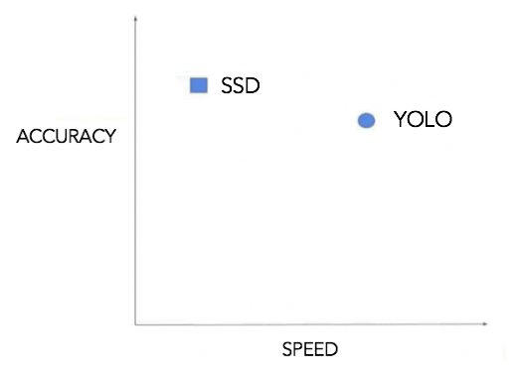
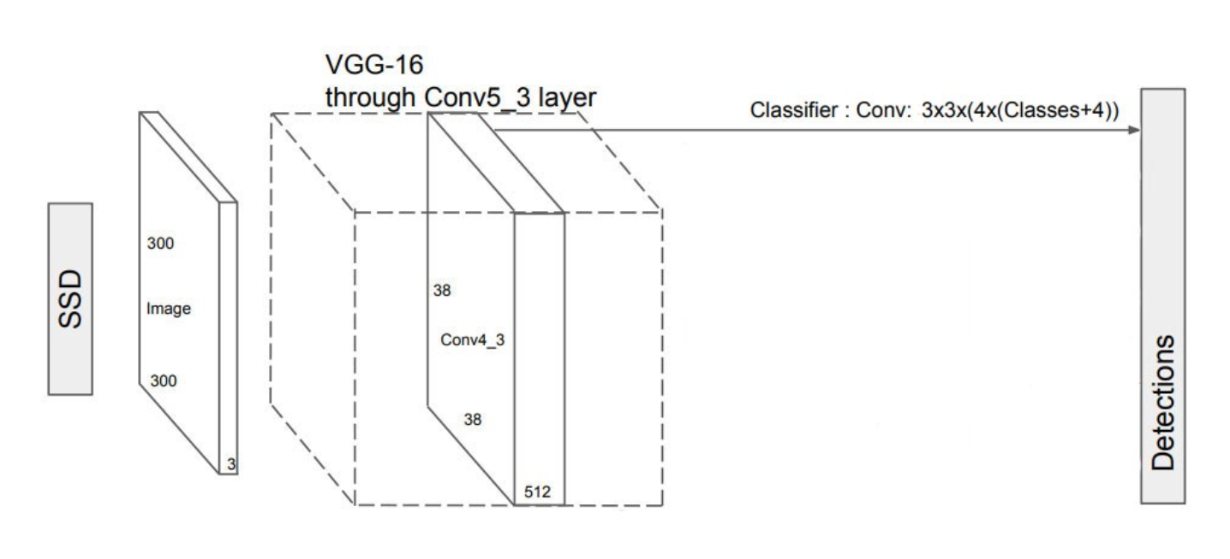
Single Shot Detector (SSD)
Splits an image into default boxes
Each box has an intersection over union value(IOU)
A threshold value is selected
If the default box has an IOU value within the threshold
then object detected
Figure. Comparison of SSD and YOLO
Figure. Architecture of SSD
Notes:
Generate SSD model
Covert SSD model with train.record as input
Use trained model to perform pothole detection on test images
Popular for object detection
Works better than standard neural network
Extracts feature maps
Apply convolution filters to detect objects
Accuracy increases with number of boundary boxes

Slide 9
https://pranavprem.github.io/
https://pranavprem.github.io/
 | YOLO | SSD | CNN | Faster RCNN
Why? | Speed Different from other object detection algorithms because it only needs to “see” an image once Swift so can be run real time | Speeds up process by eliminating the need of region proposal network Provides matchable accuracy while using lower resolution images | Uses feature learning to find most relevant pattern for classification | Uses RPN to generate fix set of regions Uses anchor boxes for object detection Faster speed because of regional proposals (real-time object detection)

Slide 10
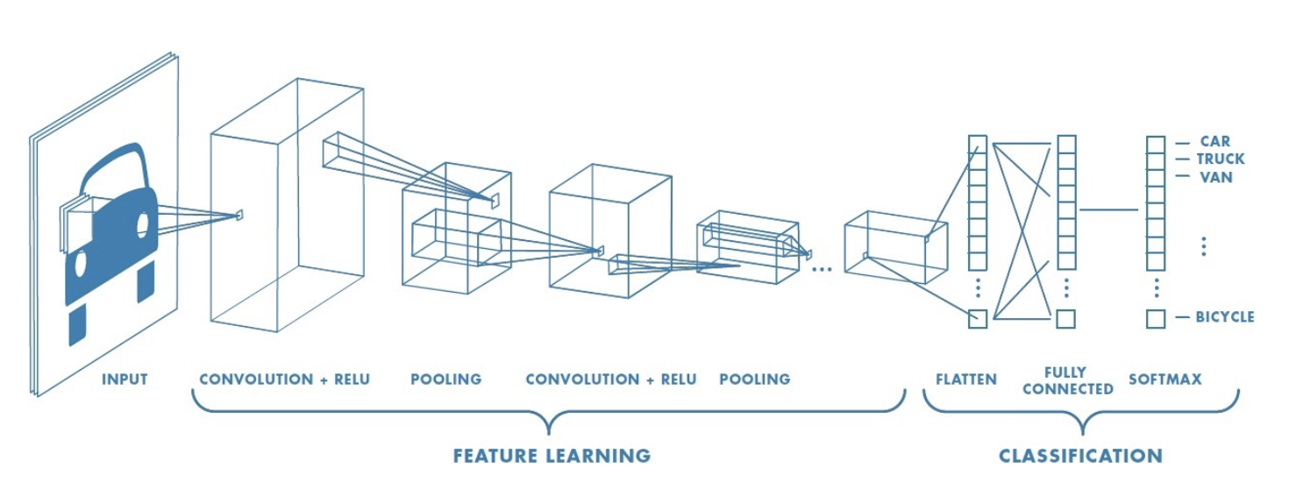
CNN
Figure. Architecture of CNN
Notes:
Provide image
Choose params, apply filters, add padding
Perform convolution on the image
Perform pooling to reduce # of params
Add more convolutional layers if needed
Flatten output and feed to the FC layer
Output the class

Slide 11
 | YOLO | SSD | CNN | Faster RCNN
Why? | Speed Different from other object detection algorithms because it only needs to “see” an image once Swift so can be run real time | Speeds up process by eliminating the need of region proposal network Provides matchable accuracy while using lower resolution images | Uses feature learning to find the most relevant pattern for classification | Uses RPN to generate fix set of regions Uses anchor boxes for object detection Faster speed because of regional proposals (real-time object detection)

Slide 12
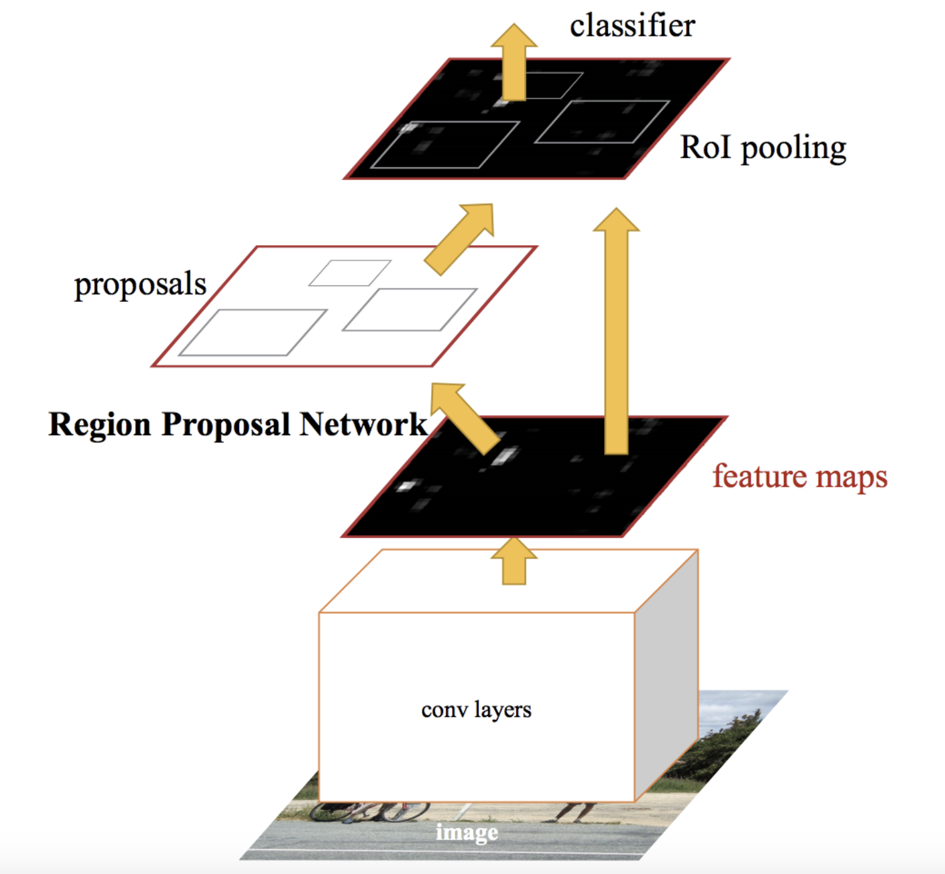
Faster R-CNN
Image goes through convolution layers → feature maps are extracted
A sliding window is used in RPN for each location over the feature map
For each location, anchor boxes are used for generating region proposals
cls layer for finding object
reg layer to get coordinates
Figure. Architecture of Faster R-CNN
Notes:
2 networks:
RPN to generate region proposals
a network that uses the region proposals to detect objects

Slide 13
 | YOLO | SSD | CNN | Faster RCNN
Why? | Speed Different from other object detection algorithms because it only needs to “see” an image once Swift so can be run real time | Speeds up process by eliminating the need of region proposal network Provides matchable accuracy while using lower resolution images | Uses feature learning to find most relevant pattern for classification | Uses RPN to generate fixed set of regions Uses anchor boxes for object detection Faster speed because of regional proposals (real-time object detection)

Slide 14
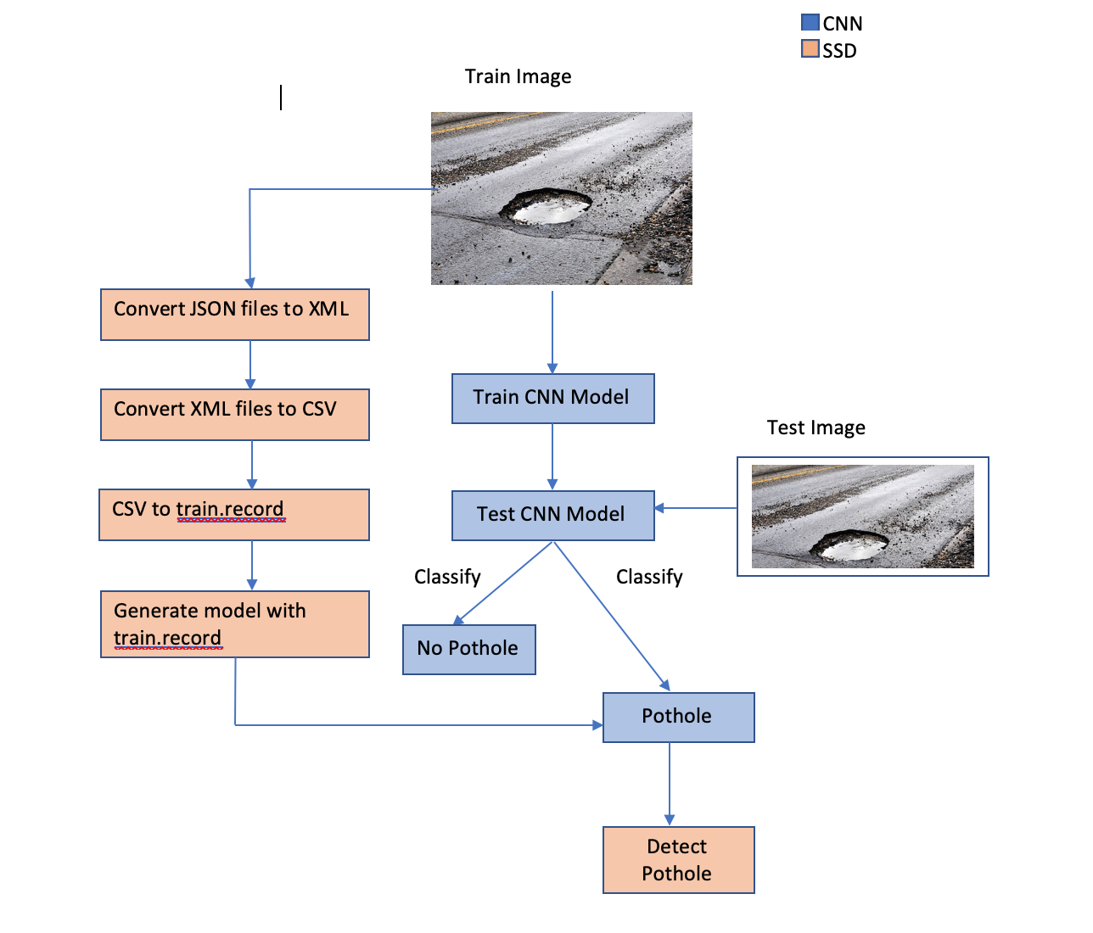
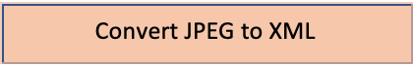
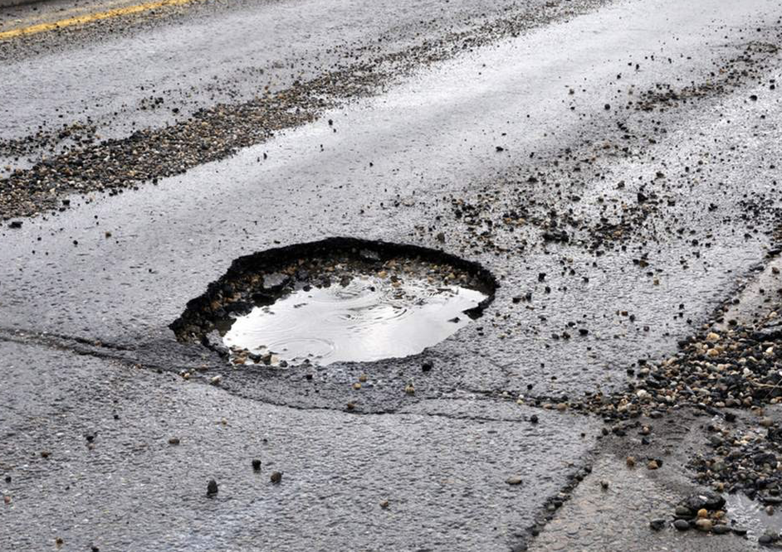
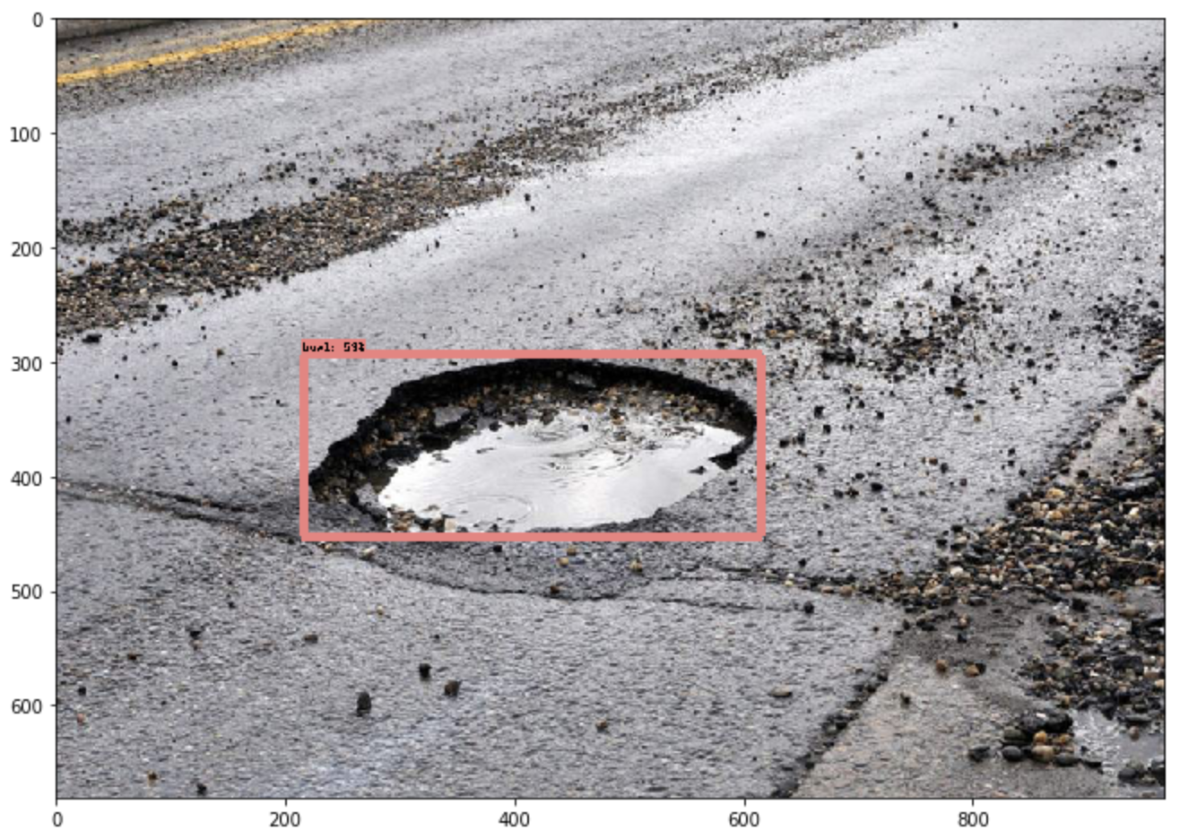
Model Architecture

Slide 15
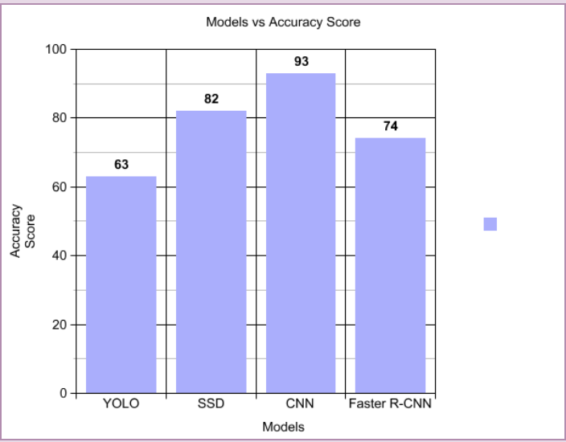
Comparison
 | YOLO | SSD | CNN | Faster RCNN
Accuracy | 63% | 82% | 93% | 74%
Improve Accuracy Techniques:
Use bigger Training Set
Use images with prominent potholes instead of car dashboard view images.
Combination of Algorithms

Slide 16
Conclusion/Further Work
YOLO is efficient with large pothole images instead of dashboard images
SSD is efficient but needs large number of training dataset
HPC was highly unreliable during our experiment
Further Work:
Can be expanded to object detection in video for real time applications

Slide 17
Thank You

